Slide 2

SPACESHIP TITANIC
Presented by
Rafi Baig – rbaig@kent.edu
Suresh Daggupati – vdaggupa@kent.edu
Kavya Gandu – kgandu@kent.edu
Image Reference: https://www.kaggle.com/competitions/spaceship-titanic

Slide 3
Overview
Introduction
Project Objectives
Stakeholder & End Users
Constraints imposed by the Customer
Assumptions and Risks
Tools Utilized
Literature Review
Methodology
Results & Demo
References

Slide 4
Introduction
Spaceship Titanic was an interstellar spaceship that transport people from one planet to other. It has a capacity to carry almost 13,000 passengers.
Collided with a spacetime anomaly hidden within a dust cloud. The collision created a disturbance in the orbit and almost half of the passengers transported to an alternate dimension

Slide 5
Project Objectives
To predict which passengers are transported by the anomaly and thus help rescue crews and retrieve passengers using records recovered from the interstellar spaceship’s damaged computer system.
Statistically, this task follows classification problem and here we will be implementing various classification techniques and compare their performance results.
Performance evaluation will be based on Classification Accuracy.

Slide 6
Stakeholder
sourave Redwanul Haque is a Ph.D. Candidate in computer science department. sourave worked in Samsung Research & Development institute and expert in Machine Learning also good in C++ development. Currently he is working as Teaching Assistant in Kent State University.
Email: rsourave@kent.edu
.
End Users
Regarding this task, this prediction will help the rescue crews and can bring back the lost passengers. Considering this fact, we can say that our end users for this challenge is ship crew.

Slide 7
Constraints Imposed by the Customer
Project needs to have an implementation with python version >=3.7 using any of the IDE’s.
statistical analysis to analyze the insights of data.
Weekly Report status about the project for updates and changes if required
Compare different modelling techniques with its performance results.
Good UI for presentation.

Slide 8
Assumptions and Risks
We assume that the data each passenger has ID, and it is unique for each passenger.
Data may contain outliers which needs to be cleaned.
Also, it might contain some duplicate values which need more evaluation and analysis.
Modelling will have chances for the over fitting.

Slide 9
Tools and Framework
Anaconda Navigator or PyCharm Express.
Language: Python & JavaScript
Framework : React Js

Slide 10
Literature Review
Note: Spaceship Titanic is a cosmic mystery and unseen future, typical hypothetical situation and It is a classification problem. For literature review we are analyzing improvised classification techniques considering references from the research papers.
1. Classification Based on Decision Tree Algorithm for Machine Learning (Journal of Applied Science & Technology Trends -2021)
2. PERFORMANCE OF RIDGE LOGISTIC REGRESSION AND DECISION TREE IN THE BINARY CLASSIFICATION (Journal of Theoretical and Applied Information Technology – 15th Aug 2022)
3. XGBoost and Deep Neural Network Comparison: The Case of Teams’ Performance (International Conference on Intelligent Tutoring Systems).
We aimed at classification techniques that has significant performance results in the above papers.

Slide 11
Performance Scores of Referred Papers
The results showed that DT efficiency is higher than RF, achieving 84.11 % with DT accuracy, while 58.11 % with RF accuracy[1].
The KNN classification is better than the DT classification in the PCA feature extraction. The accuracy of KNN reaches 86.7% while the DT reaches 83.3%[1].
They achieved accuracy score of 84% using Ridge logistic regression and 81% using decision tree [2].
Predication accuracy of XGBOOST and DNN was found to be 80.50% and 77.36%[3].

Slide 12
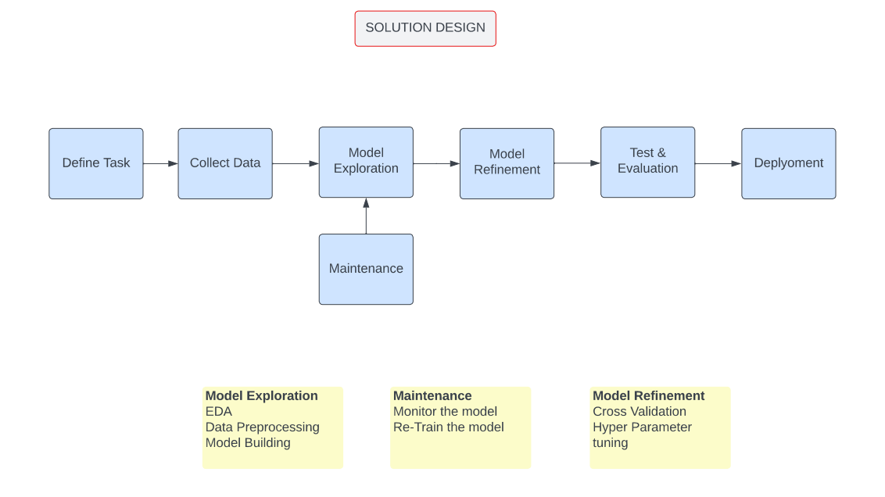
Methodology

Slide 13
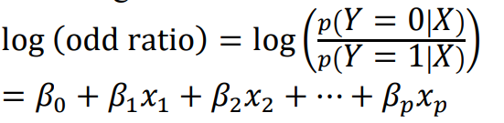
Ridge Logistic Regression
Logistic regression is a linear classification model that performs very satisfactorily for the classification of linearly separable binary class data sets
Regularization of L2 norm and tree pruning is intended to handle an over-fitting problem.
The equation is a linear combination between predictor features and associated weights.
The problem is solved by maximizing likelihood function

Slide 14
Extra Tree Classifier
Each decision stump will be built with the following criteria:
All the data available in the training set is used to build each stump.
To form the root node or any node, the best split is determined by searching in all the available features.
The maximum depth of the decision stump is one.

Slide 15
Random Forests
A bootstrap will be created by randomly sampling the training set with replacement. The size of the bootstrap is set to equal the size of the training set.
To form the root node or any node, the best split is determined by searching in a subset of randomly selected features of size sqrt(number of features). In our case, each decision stump is allowed to inspect two out of the four features.
The maximum depth of the decision stump is one.

Slide 16
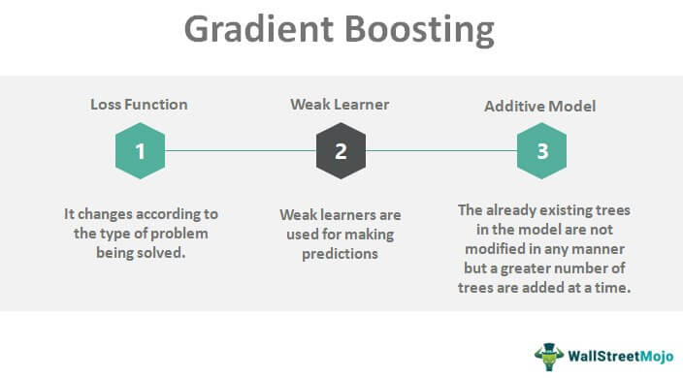
Gradient Boosting
A big insight into bagging ensembles and random forest was allowing trees to be greedily created from subsamples of the training dataset.
This same benefit can be used to reduce the correlation between the trees in the sequence in gradient boosting models.

Slide 17
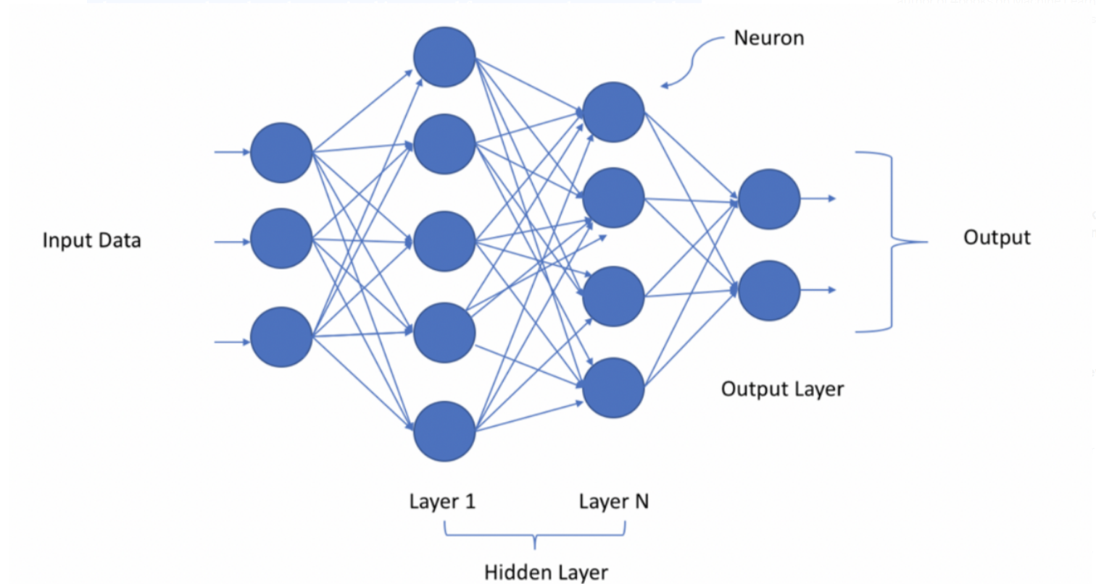
Deep Neural Networks

Slide 18
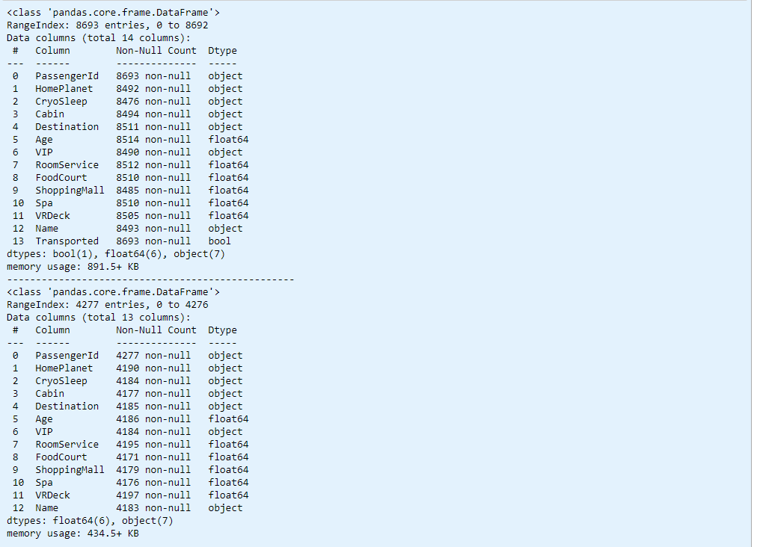
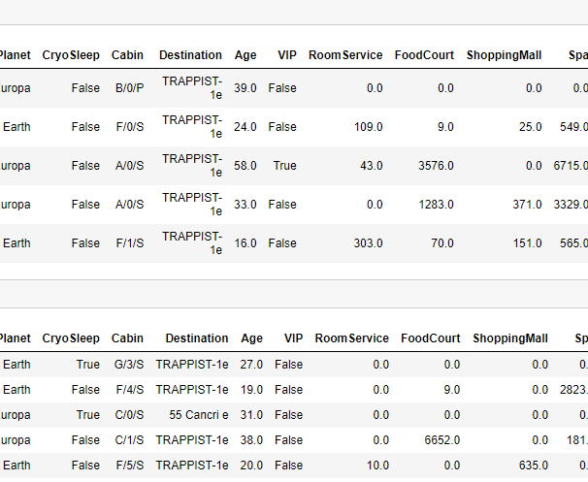
Data Analysis

Slide 19
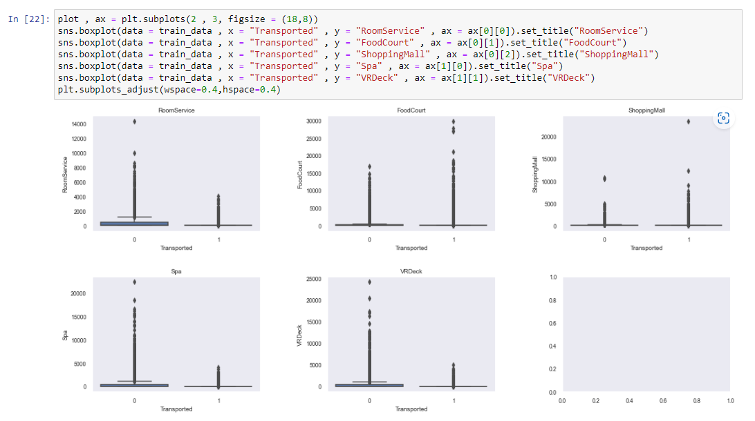
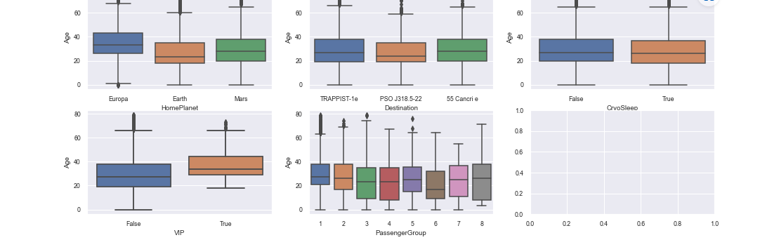
Plots for Outliers

Slide 20
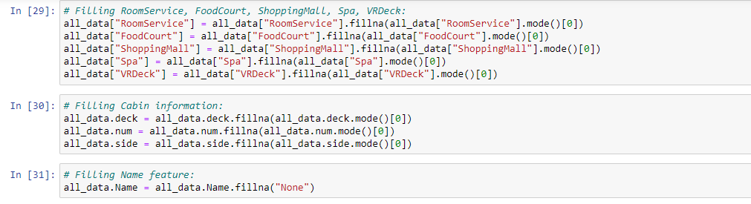
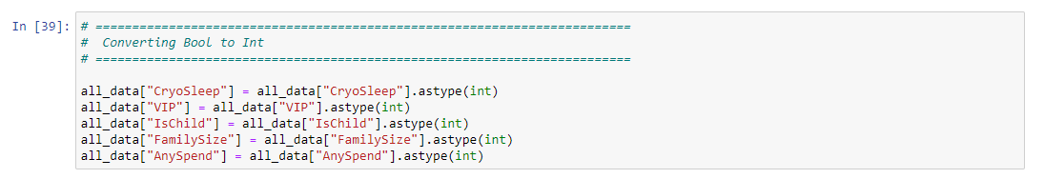
Feature Engineering

Slide 21
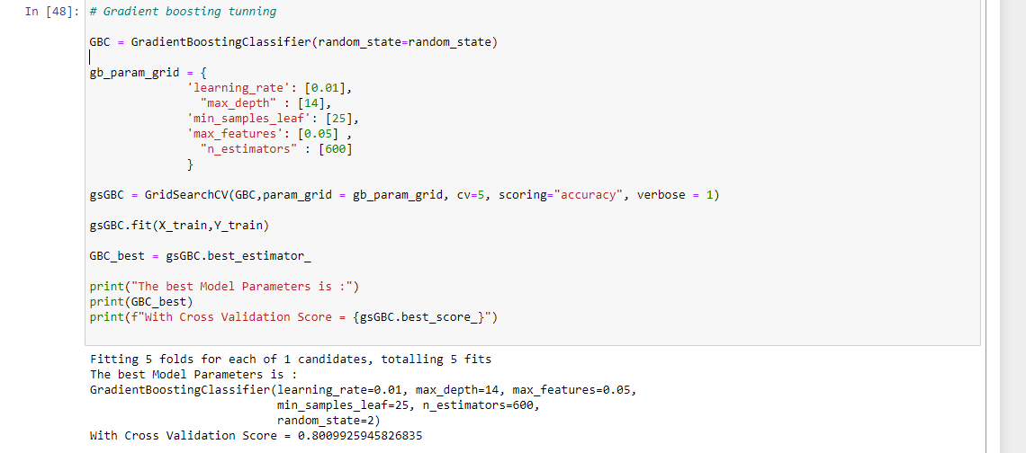
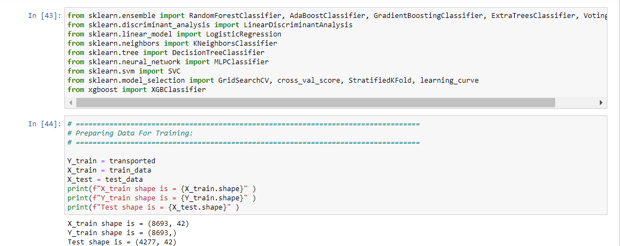
Modelling Code

Slide 22
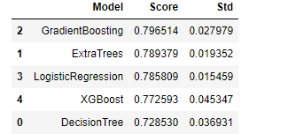
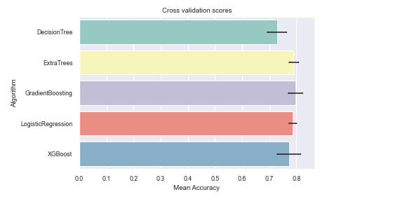
Results & Demo

Slide 23
References
https://www.jastt.org/index.php/jasttpath/article/download/65/24
https://www.researchgate.net/profile/Samingun-Handoyo/publication/362694090_PERFORMANCE_OF_RIDGE_LOGISTIC_REGRESSION_AND_DECISION_TREE_IN_THE_BINARY_CLASSIFICATION/links/62f9bf61c6f6732999cfae38/PERFORMANCE-OF-RIDGE-LOGISTIC-REGRESSION-AND-DECISION-TREE-IN-THE-BINARY-CLASSIFICATION.pdf
https://link.springer.com/chapter/10.1007/978-3-030-80421-3_37

Slide 24
Thank You

